Slide 1
Lecture-29
Mathematics 2 (15B11MA211)
CO [C106.6]
Topic: Complex integral, contour integral
Reference for the lecture
R.K Jain and S.R.K. Iyenger, “Advanced Engineering Mathematics” fifth edition, Narosa publishing house, 2016.
B. S. Grewal, “Higher Engineering Mathematics” 42nd -Edition, Khanna Publisher, New Delhi

Slide 2
Topics Covered
Complex integral
Properties
Examples

Slide 3
Integration of complex functions
Integration of functions of a complex variable plays an important role in many fields of science and engineering. It can be used to evaluate many improper integrals of a real variable, which can’t be easily evaluated using real integral calculus.

Slide 4
Complex Integral
As in case of functions of a real variable, for function f(z) of a complex variable z =x +i y, we have the line integrals written as
The curve C is called Contour
The curve C is a continuous piecewise smooth curve between the points z₀ and z₁. This means that curve has a continuously turning tangent or the curve is defined by a single valued function having continuous derivative.
Value of the integral may depend on path. If the value is independent of the path, the integral changes to definite integral and

Slide 5
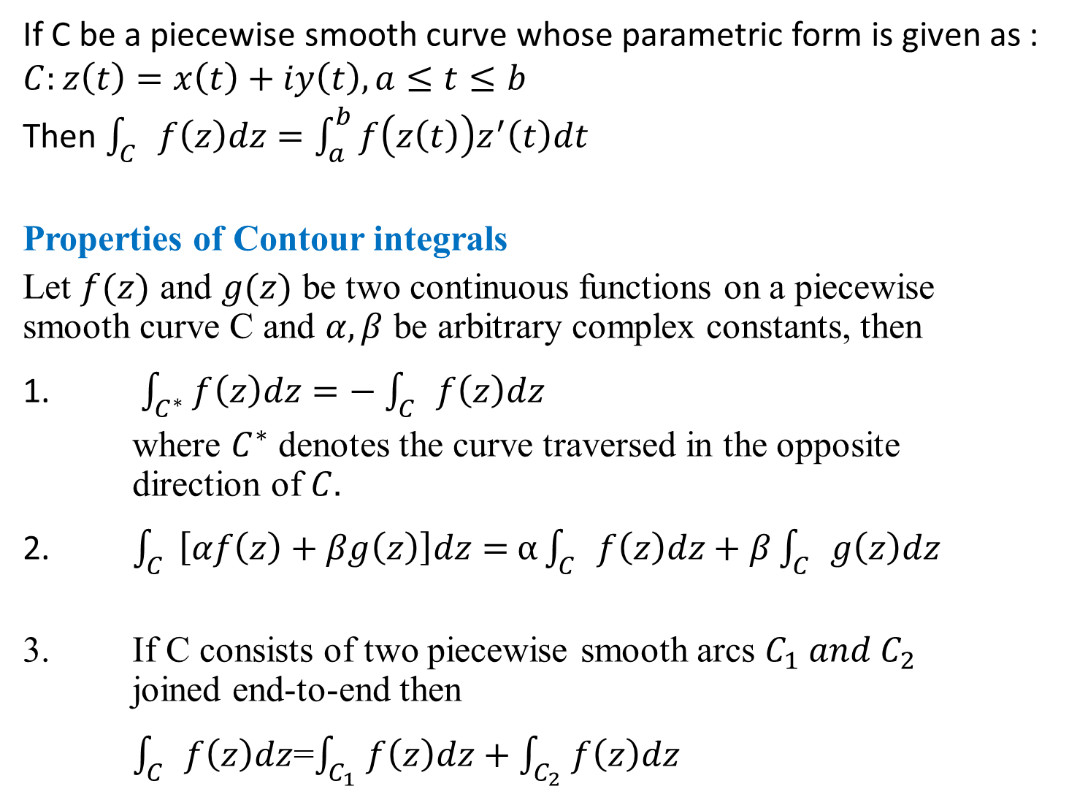
If C be a piecewise smooth curve whose parametric form is given as : $C:z\left(t\right)=x\left(t\right)+iy\left(t\right), a≤t≤b$
Then $\int_{C}{f\left(z\right)dz=\int_{a}^{b}{f\left(z\left(t\right)\right)z^{′}\left(t\right)dt}}$
Properties of Contour integrals
Let $f(z)$ and $g(z)$ be two continuous functions on a piecewise smooth curve C and $α,β$ be arbitrary complex constants, then
1. $\int_{C^{∗}}{f\left(z\right)dz=−}$ $\int_{C}{f\left(z\right)dz}$
where $C^{∗}$ denotes the curve traversed in the opposite direction of $C.$
2. $\int_{C}{\left[αf\left(z\right)+βg\left(z\right)\right]dz=}$ $α\int_{C}{f\left(z\right)dz+β\int_{C}{g\left(z\right)dz}}$
3. If C consists of two piecewise smooth arcs $C_{1} and C_{2}$ joined end-to-end then
$\int_{C}{f\left(z\right)dz}$=$\int_{C_{1}}{f\left(z\right)dz+}$ $\int_{C_{2}}{f\left(z\right)dz}$

Slide 6
Example1 : Evaluate , where C is upper part of the circle | z | = 1.
Solution:
We have on C
Y
z
C
θ
O
X

Slide 7
Example2: Evaluate , where C is lower part of the circle | z | = 1.
Hint: Here
Answer:

Slide 8
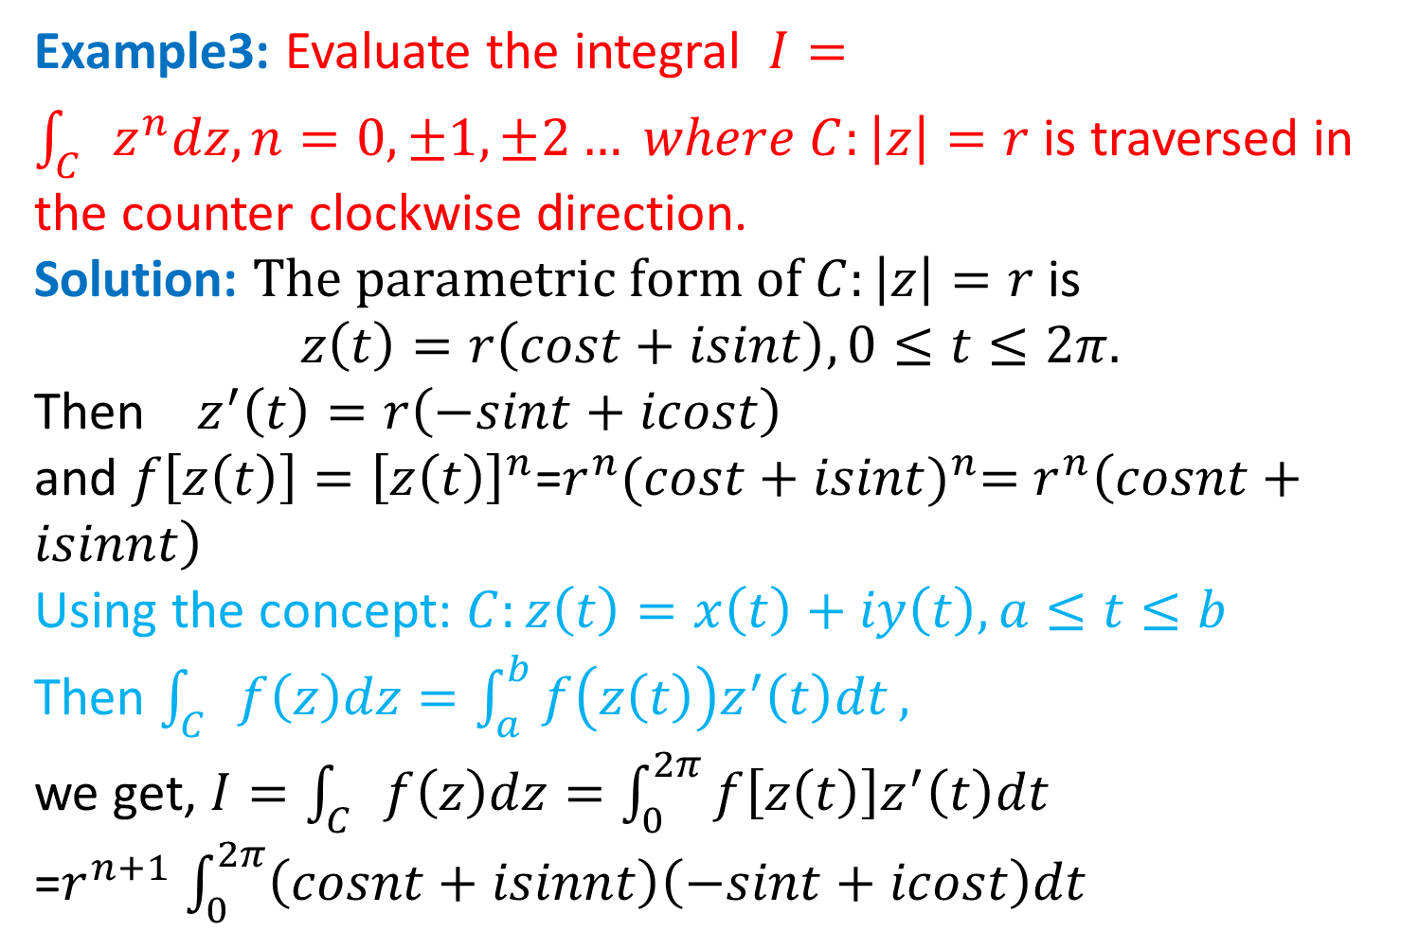
Example3: Evaluate the integral $I=\int_{C}{z^{n}dz, n=0,±1,±2…} where C:\left|z\right|=r$ is traversed in the counter clockwise direction.
Solution: $The parametric form of C:\left|z\right|=r$ is
$$z\left(t\right)=r\left(cost+isint\right), 0≤t≤2π.$$
Then $z^{′}\left(t\right)=r\left(−sint+icost\right)$
and $f\left[z\left(t\right)\right]={\left[z\left(t\right)\right]}^{n}$=$r^{n}{(cost+isint)}^{n}=$ $r^{n}\left(cosnt+isinnt\right)$
Using the concept: $C:z\left(t\right)=x\left(t\right)+iy\left(t\right), a≤t≤b$
Then $\int_{C}{f\left(z\right)dz=\int_{a}^{b}{f\left(z\left(t\right)\right)z^{′}\left(t\right)dt}},$
we get, $I=\int_{C}{f\left(z\right)dz=\int_{0}^{2π}{f\left[z\left(t\right)\right]z^{′}\left(t\right)dt}}$
=$r^{n+1}$ $\int_{0}^{2π}{\left(cosnt+isinnt\right)\left(−sint+icost\right)dt}$

Slide 9
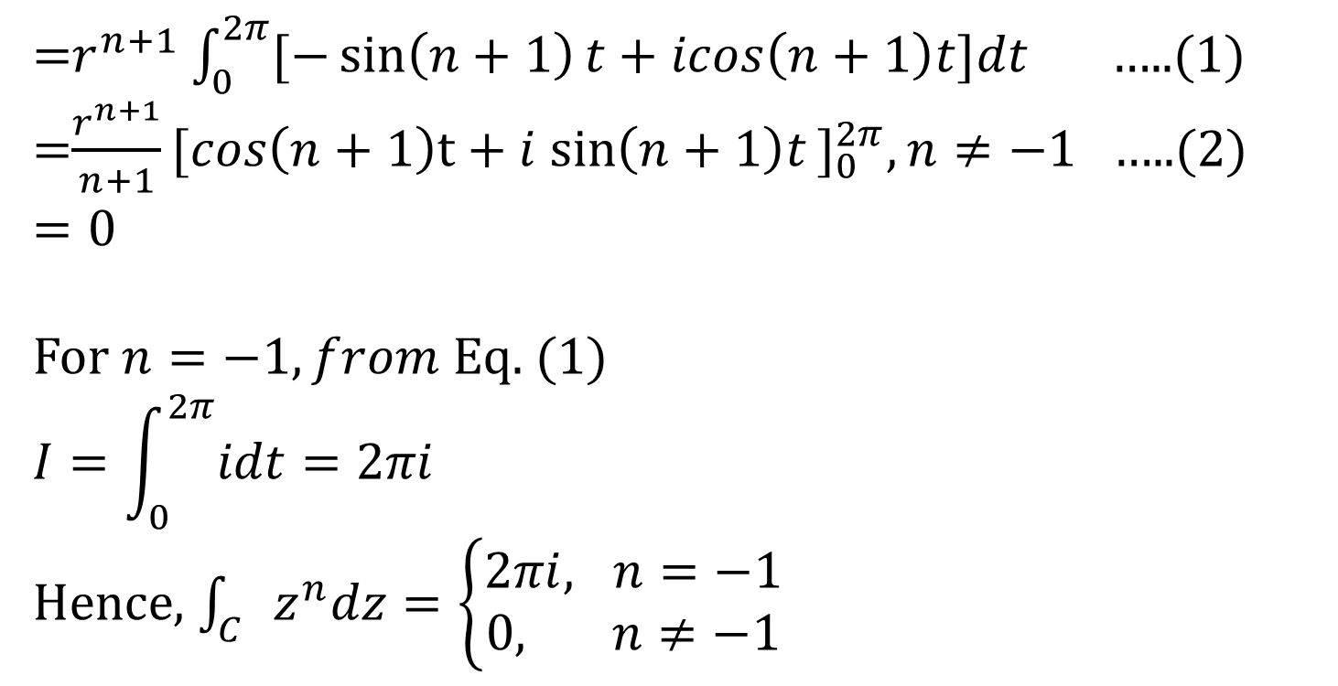
=$r^{n+1}$ $\int_{0}^{2π}{[−\sin\left(n+1\right)t+icos\left(n+1\right)t]dt}$ …..(1)
=$\frac{r^{n+1}}{n+1}{[cos\left(n+1\right)t+i sin\left(n+1\right)t\text{]}}_{0}^{2π},n≠−1$ …..(2)
$$=0$$
For $n=−1, from$Eq. (1)
$$I=\int_{0}^{2π}{idt=2πi}$$
Hence, $\int_{C}{z^{n}dz=\left\{\begin{aligned}2πi, n=−1 \\ 0, n≠−1\end{aligned}\right.}$

Slide 10
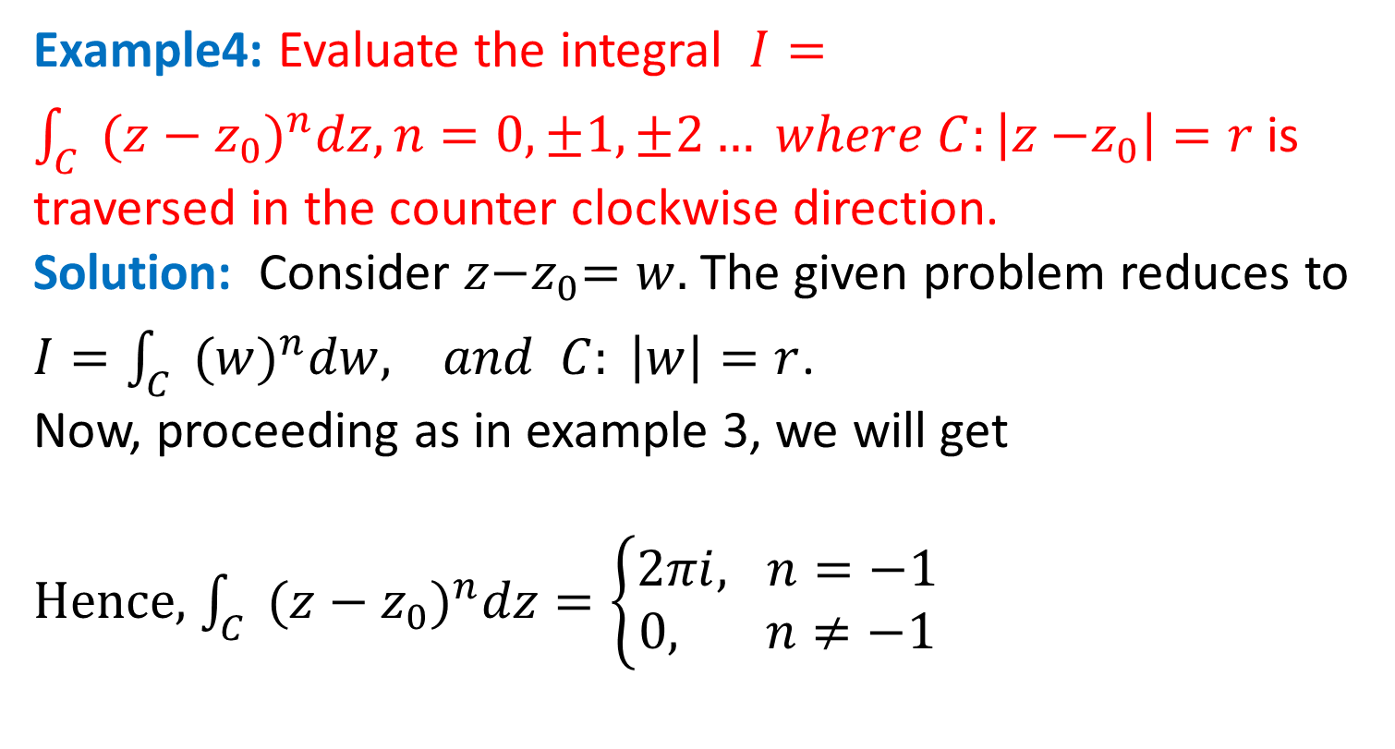
Example4: Evaluate the integral $I=\int_{C}{(z−{z_{0})}^{n}dz, n=0,±1,±2…} where C:\left|z{−z}_{0}\right|=r$ is traversed in the counter clockwise direction.
Solution: Consider $z{−z}_{0}=w.$The given problem reduces to $I=\int_{C}{(w)^{n}dw, and C: \left|w\right|=r}$.
Now, proceeding as in example 3, we will get
Hence, $\int_{C}{(z−{z_{0})}^{n}dz=\left\{\begin{aligned}2πi, n=−1 \\ 0, n≠−1\end{aligned}\right.}$

Slide 11
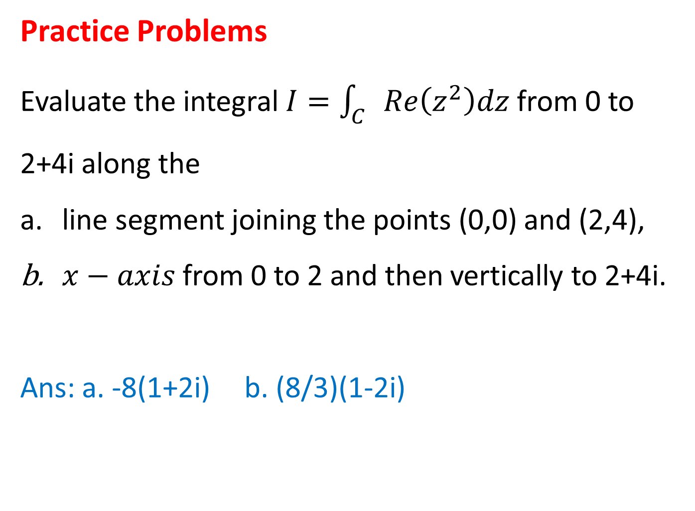
Practice Problems
Evaluate the integral $I=\int_{C}{Re\left(z^{2}\right)dz}$ from 0 to 2+4i along the
line segment joining the points (0,0) and (2,4),
$x−axis$ from 0 to 2 and then vertically to 2+4i.
Ans: a. -8(1+2i) b. (8/3)(1-2i)

Slide 12
Thank You

